Slide 1
2023-2024
Senior/ Parent Presentation
Josh Gordon
College Access Specialist
jgordon@bisdtx.org
Sept. 21, 2023

Slide 2
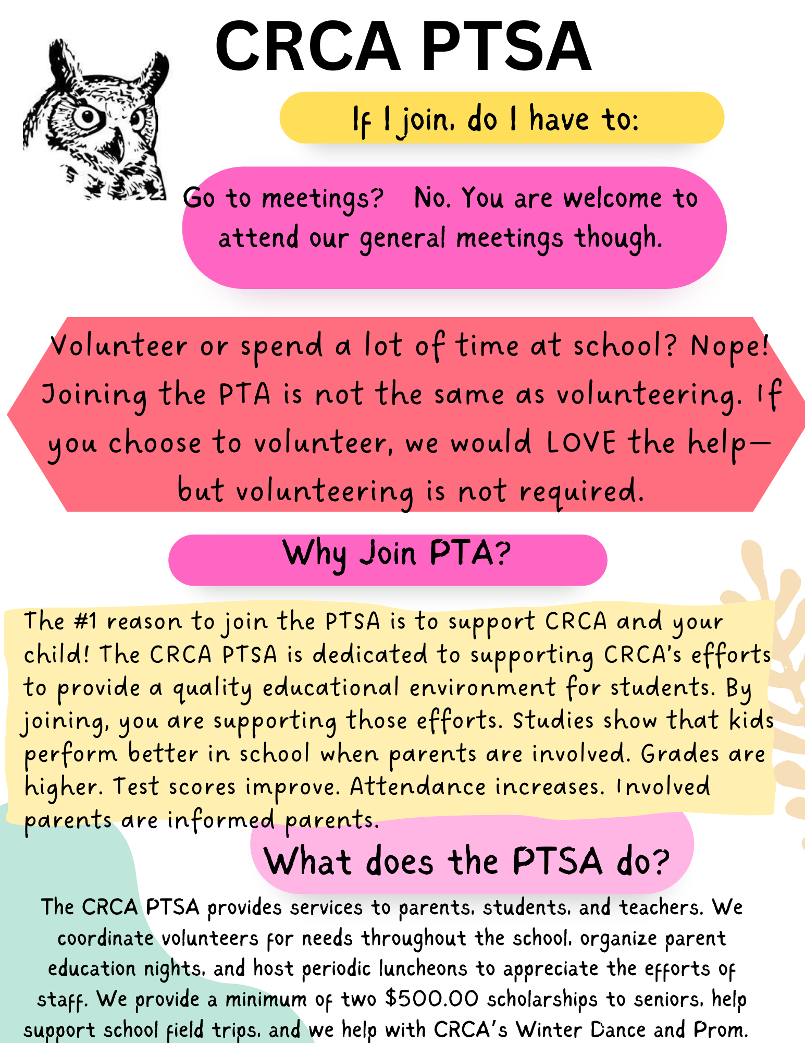

Slide 3
What will my school week look like?
Seniors are taking classes at an ACC campus Monday through Thursday and are at CRCA on Fridays.
Seniors are enrolled in the following classes for the FALL semester:
•Math 1332 College Mathematics (3 credits)
Math 2412 Pre-Calculus (4 credits)
Or Calculus (4 credits)
•GOVT 2305 US Government (3 credits)
•ECON 2301 Principles of Macroeconomics (3 credits)
•BIOL 1406 Cellular and Molecular Biology
Or BIOL 1408 Biology for Non-Science Majors (4 credits)
people

Slide 4
What will my school week look like?
Seniors are enrolled in the following classes for the SPRING semester:
TX GOVT 2306 Texas Government (3 credits)
Biology 1309 Life on Earth (3 credits)
Or Biology 1407 Structure and Function of Organisms (4 credits)
ENGL 2322 British Literature (3 credits)
PSYC 2301 Psychology (3 credits)
For a total of 60 college credits
people

Slide 5
Attendance Austin Community College
Students must make every effort to attend all of their classes at ACC.
If a student is going to miss a class at ACC, they MUST CONTACT THEIR ACC PROFESSOR prior to class and make every effort to submit their assigned work prior to the class date.
B. Professors may or may NOT excuse the absence and the student’s grade may be penalized.
C. STUDENTS MUST FOLLOW THE ACC CALENDAR. So, that means students still have class at ACC on BISD student holidays and half days.
9

Slide 6
School Safety
1. Front doors (East) to the campus are to remain locked at all times.
2. Exterior doors on the south side of the campus are to remain locked at all times.
3. Teachers doors are to remain closed and locked at all times.
4. Students must not open the front doors or the courtyard gates for anyone…including parents.
5. Parents should only enter the campus through the front doors. We have posted the number to the campus for you to call and be let in.
6. Students really should not be using the restroom during class time.
7. Students should take all of our drills seriously.
9

Slide 7
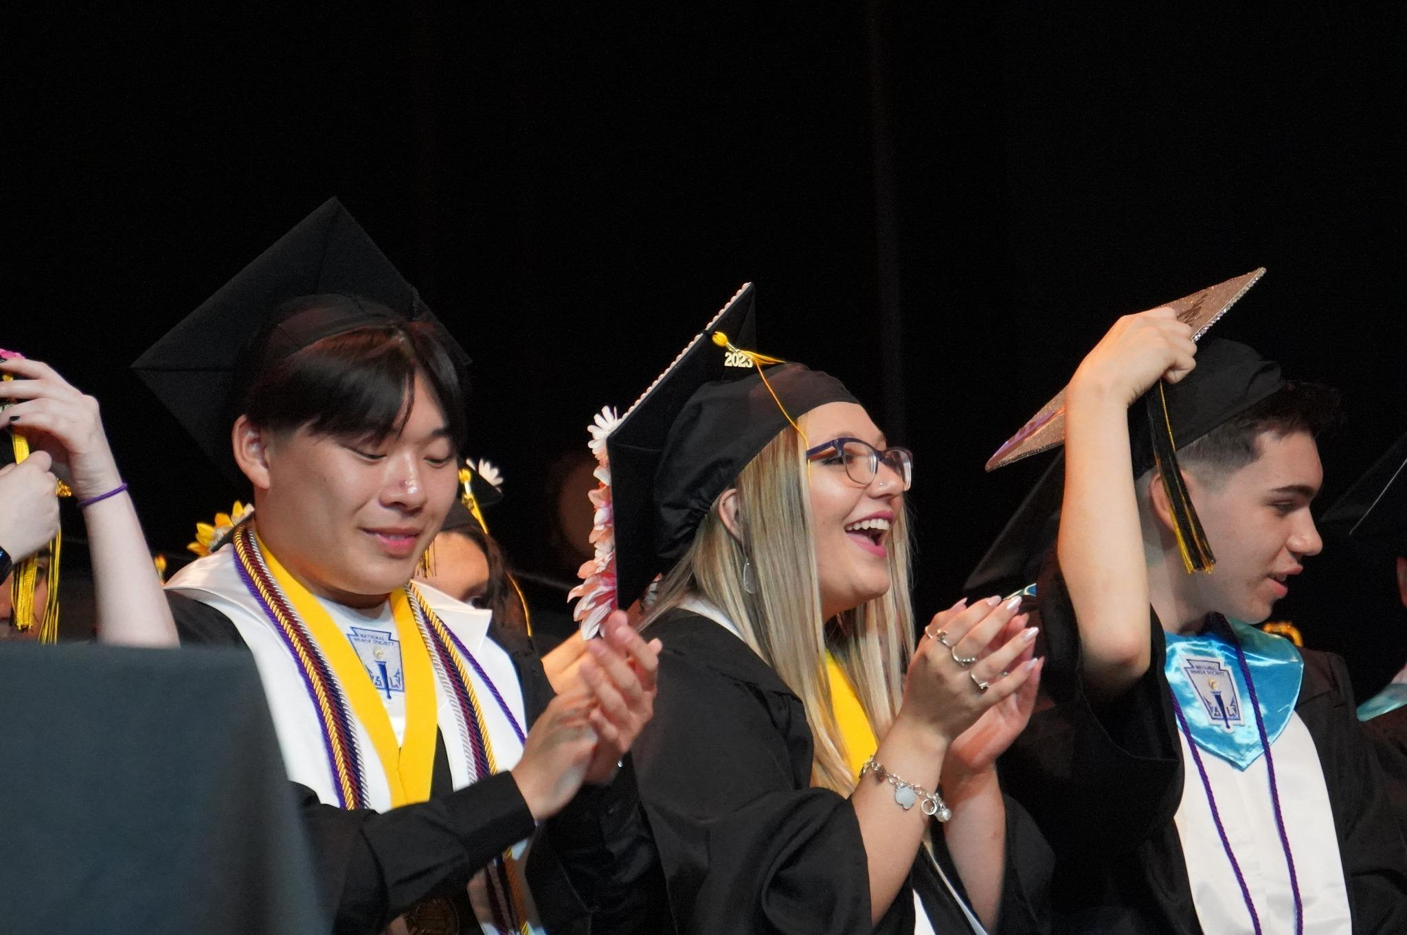
CRCA Graduation Fri. May 24 @ PAC
Mrs. Jimenez and Mr. Gordon will meet with all seniors to discuss their current academic status.
Seniors need to pass the following classes to satisfy high school graduation requirements.
Government 2305- US Government
Economics 2301- Principles of Macroeconomics
English 2322- British Literature (with Mrs. Sharp)
people

Slide 8
Repeating ACC Courses
The cost of courses/ books that are being repeated because the student withdrew from, failed, or earned a D in the course the previous semester or year, will be paid by the student and their family.
The current tuition ACC charges CRCA students is $150 per course.
Payments for repeated or in lieu of courses, including those taken during the summer, will be made to CRCA and are due by the last day of drop.
people

Slide 9
Satisfactory Academic
Progress
(SAP)
It is absolutely essential that your student maintains or achieves the following in order to qualify for state and federal financial aid for their undergraduate college education:
A MINIMUM of 2.0 GPA
A MINIMUM of a 67% Completion Rate
9

Slide 10
What’s Next?
4 year University
Continue at Community College
Trade/ Technical School
Military
Job
Cat has a hat

Slide 11
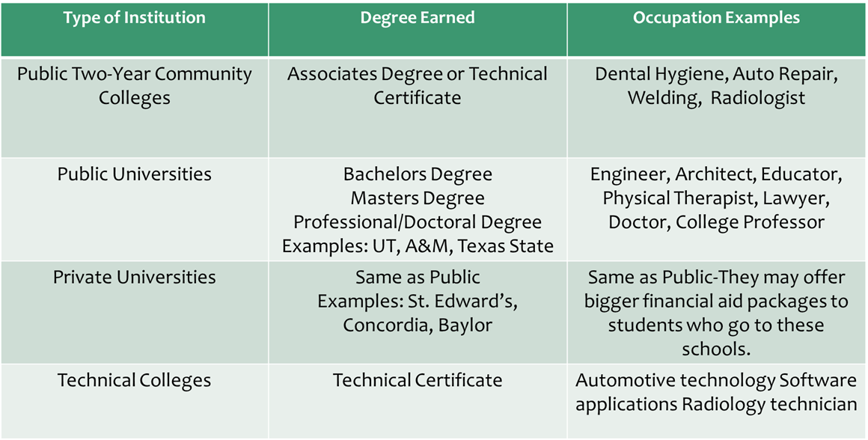
What’s Next?

Slide 12
What to consider when choosing a College:
Most Important Considerations:
Location
Size
Program/ Degree
Cost
Where do you fit in?
Other
Considerations:
Graduation Rate
Housing
Legacy
Religion
Relationship
Cat has a hat

Slide 13
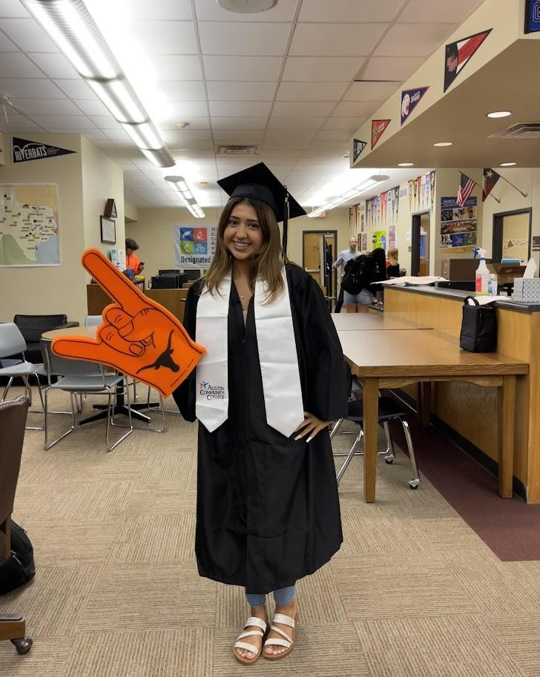
College Tours
You are allowed two excused College Visitation Days.
Try to use these on a Friday, so that you do not miss ACC.
You must complete the College Visitation Form and submit it to Mr. Gordon. It can be found in the Google Classroom.
Cat has a hat

Slide 14
How Do I Choose A Major?
A major is your primary field of study you plan to get a job in after you graduate, such as engineering, education, or graphic design.
When choosing a major ask yourself:
What are my interests?
What are the job prospects? Income potential?
What is my personality?
Cat has a hat

Slide 15
2022’s 10 Most Popular
College Majors
https://www.bestcolleges.com/blog/most-popular-college-majors/
Business
Health Professions
Social Sciences and History
Engineering
Biological and Biomedical Sciences
Psychology
Communication and Journalism
Visual and Performing Arts
Computer and Information Sciences
Education
Cat has a hat

Slide 16
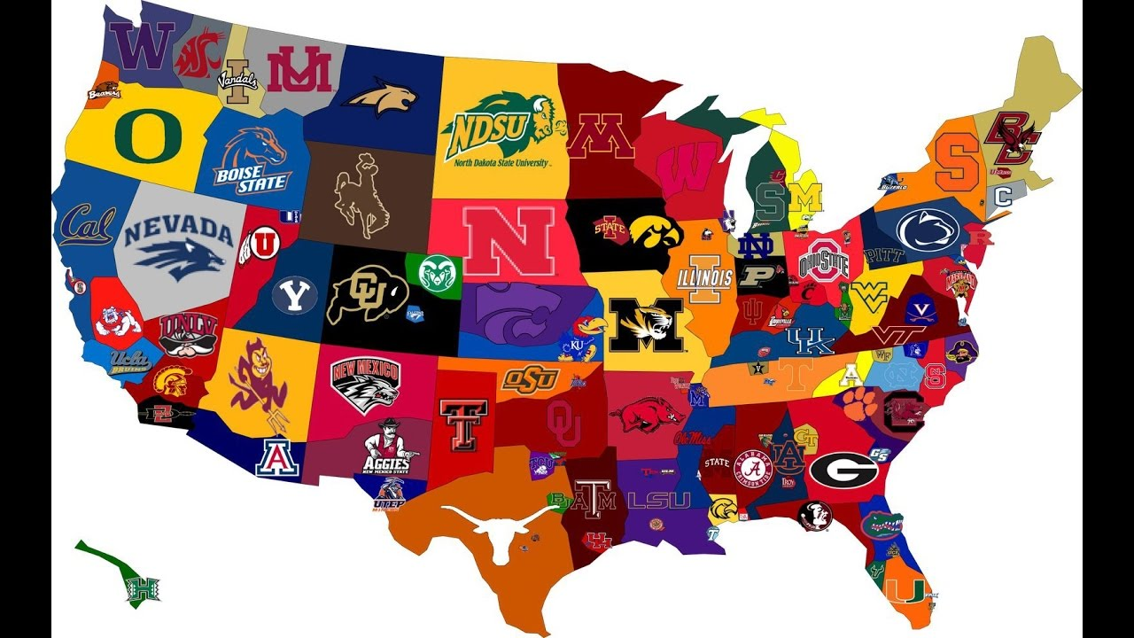
What Do Colleges Look At?
Grades/GPA/Class Rank
Courses
Essays ( Apply Texas essay prompt is in the Google Classroom)
Letters of recommendation
Extracurricular activities, awards, volunteer hours
Employment
Cat has a hat

Slide 17
What About the SAT/ ACT?
Getting a good score can help students get in a better school or
receive scholarships.
We are requiring all seniors to take the SAT at least once. We will be offering the SAT on Thurs. Oct. 26 at CRCA.
Most colleges will accept either the SAT or ACT.
SAT fee waivers are available from Mrs. Jimenez. Fee waivers can also be used for college applications. Must be eligible for free or reduced lunch.
Cat has a hat

Slide 18
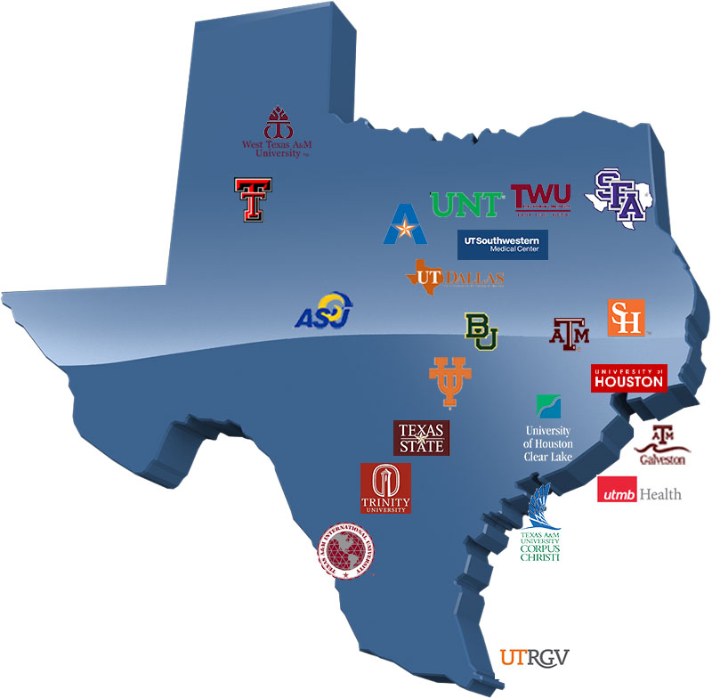
Top Ten Percent
Admission to public postsecondary institutions in Texas is guaranteed to students who graduate in the top 10% of their class at a public or private accredited high school.
Except for the University of Texas at Austin... UT only guarantees acceptance to the top 6% of the graduating class.
Cat has a hat

Slide 19
How do CRCA students apply for College
Freshman or transfer student?
You will submit an application as a freshman applicant since you have not yet graduated from high school.
Upon high school graduation, you will work with your college admissions counselor/advisor and they will apply your college credit that was earned while in high school to your degree plan (if it meets their academic requirements)
Cat has a hat

Slide 20
How do I apply to University?
You can apply to most Texas universities using
https://applytexas.org/
For out-of-state universities, you can usually apply using https://www.commonapp.org/
Caution: Out-of-state and private universities may not accept any or all
of your college credits.
Cat has a hat

Slide 21
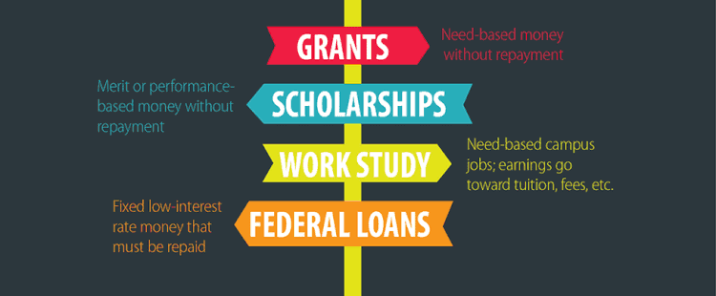
How do I pay for College?
Cat has a hat

Slide 22
How do I pay for College?
FAFSA- Free Application for Federal Student Aid
https://studentaid.gov/
FAFSA goes live on December 1st.
Please join us on
Weds. Nov. 15 from 4:10-7:30 PM
for a FAFSA Workshop in the CRCA library.
Cat has a hat

Slide 23
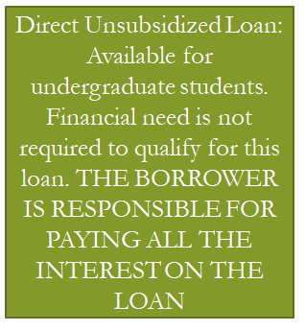
Types of Federal Loans
LOANS HAVE TO BE REPAID WITH INTEREST
AA
Cat has a hat

Slide 24
Scholarships
Search for scholarships that match your interests and strengths, future major, career, or university, etc.
You can’t get scholarships unless you apply for scholarships.
Here are a few websites:
www.unigo.com
www.scholarship.com
www.collegeforalltexans.com
I will also create a list of local scholarships for students to apply to. This will be released in December.
Cat has a hat

Slide 25
THANK YOU!
Are there any questions?
Plan to Attend:
Wednesday, Apr. 24th
Senior Parent College Night
6:00 PM in the CRCA Library
Any questions please contact
Josh Gordon at jgordon@bisdtx.org
Or
Tiffany Jimenez at tijimenez@bisdtx.org

